Slide 1
English For
Computer Science
Chapter 7 Programming Languages

Slide 2
What we need to know:
Terms and definitions of programming languages
Machine language and assembly language
Compilers and interpreters
计算机专业英语
1-<number>

Slide 3
7.1 Computer Languages
New Words & Expressions:
evolution n. 发展，演变 primitive 原始的，
appropriating 适当的 interpreter 解释程序
compiler 编译器 intermediary 中间的
invoke 调用 premium 额外费用，奖金
cryptic 秘密(含义模糊)的 esoteric 深奥的 [ɛsə ˈtɛ rɪ k]
prompt n.提示符
计算机专业英语
1-<number>

Slide 4
7.1 Computer Languages
Computer languages have undergone dramatic evolution since the first electronic computers were built to assist in telemetry calculations during World War Ⅱ.
Early on, programmers worked with the most primitive computer instructions: machine language. These instructions were represented by long strings of ones and zeros.
Soon, assemblers were invented to map machine instructions to human-readable and manageable mnemonics, such as ADD and MOV.
自从第一代电子计算机在第二次世界大战中用于遥测计算以来，计算机语言已发生了巨大的变化。早期编程员使用最原始的计算机指令——机器语言来工作。
这些指令由一长串的0、1组成。不久，发明了汇编程序，它能将机器指令转换成易读、易管理的助记符，如ADD、MOV等。
[nɪˈmɑnɪks]
计算机专业英语
1-<number>

Slide 5
7.1 Computer Languages
In order to become easier to use for this new audience, programs have become far more sophisticated.
Gone are the days when users typed in cryptic(秘密的,难于理解的) commands at esoteric(深奥的) prompts, only to see a stream of raw data.
为使程序更易于被新用户使用，程序本身反而变得越来越复杂。
用户需在抽象的提示符下键入难于理解的命令，只能看到一串原始数据的时代已经一去不复返了。
计算机专业英语
1-<number>

Slide 6
7.1 Computer Languages
Today’s programs use sophisticated “user-friendly interfaces,” involving multiple windows, menus, dialog boxes with which we’ve all become familiar.
The programs written to support this new approach are far more complex than those written just ten years ago.
如今，程序使用了复杂的“友好用户界面”，包含我们已很熟悉的多窗口、菜单、对话框。
支持这些新方法的程序比十年前复杂得多。
计算机专业英语
1-<number>

Slide 7
7.1 Computer Languages
Machine language（机器语言）
Machine code or machine language is a set of instructions executed directly by a computer's central processing unit (CPU).
Each instruction performs a very specific task, such as a load, a jump, or an ALU operation on a unit of data in a CPU register or memory.
Every program directly executed by a CPU is made up of a series of such instructions.
机器代码或机器语言是通过计算机中央处理器直接执行的指令集合。
每一个指令执行一个特定的任务，比如读取、跳转、或者是一个在CPU寄存器或存储器内进行的ALU的操作。
每一个直接由CPU直接执行的程序均由一系列这样的指令组成。
计算机专业英语
1-<number>

Slide 8
7.1 Computer Languages
Machine language（机器语言）
Numerical machine code (i.e., not assembly code) may be regarded as the lowest-level representation of a compiled or assembled computer program or as a primitive and hardware-dependent programming language.
数值机器代码（非汇编代码）可被认为是一个编译过的或汇编过的计算机程序的最低层次的表示，或是一个原始、基于硬件的编程语言。
计算机专业英语
1-<number>

Slide 9
7.1 Computer Languages
Machine language（机器语言）
While it is possible to write programs directly in numerical machine code, it is tedious and error prone to manage individual bits and calculate numerical addresses and constants manually.
For this reason machine code is almost never used to write programs.
直接使用数值机器代码写程序是可行的，但这种方法非常枯燥，并且在手动管理单独的比特数据、计算数值地址和常量时，容易出错。
基于上述原因，机器语言在编程中几乎不会使用。
计算机专业英语
1-<number>

Slide 10
7.1 Computer Languages
Assembly language （汇编语言）
An assembly (or assembler) language, often abbreviated ASM, is a low-level programming language for a computer, or other programmable device, in which there is a very strong (generally one-to-one) correspondence between the language and the architecture's machine code instructions.
Each assembly language is specific to a particular computer architecture.
汇编语言，缩写为ASM，是一种计算机或其他可编程设备使用的低级语言，在汇编语言里，语言和机器架构代码指令有一种非常强的关联性（一般是一对一）。
每一种汇编语言都(针对)基于一种特定的计算机架构。
计算机专业英语
1-<number>

Slide 11
7.1 Computer Languages
Assembly language （汇编语言）
In contrast, most high-level programming languages are generally portable across multiple architectures but require interpreting or compiling.
Assembly language may also be called symbolic machine code.
相对而言，大多数高级编程语言基本可在多个架构中进行移植，但移植时需要进行翻译或编译。
汇编语言又可被称为是符号化的机器语言。
计算机专业英语
1-<number>

Slide 12
7.1 Computer Languages
Assembly language （汇编语言）
Examples of assembly language
MOV AL, 1h ; Load AL with immediate value 1
MOV CL, 2h ; Load CL with immediate value 2
MOV DL, 3h ; Load DL with immediate value 3
计算机专业英语
1-<number>

Slide 13
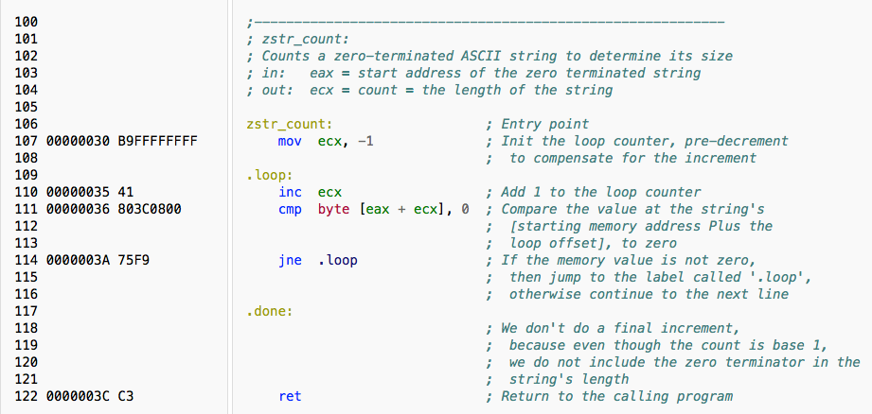
7.1 Computer Languages
Machine language VS. Assembly language
计算机专业英语
1-<number>

Slide 14
7.1 Computer Languages
In time, higher-level languages evolved, such as BASIC and COBOL. These languages let people work with something appropriating words and sentences.
Such as Let I=100. These instructions were translated back into machine language by interpreters and compilers.
随后，又推出了高级语言，如BASIC和COBOL。这些语言使用的是近似于人常用的词句，如Let I=100。这些指令由解释器或编译器翻译成机器语言。
计算机专业英语
1-<number>

Slide 15
7.1 Computer Languages
An interpreter translates a program as it reads it, turning the program instructions, or code, directly into actions.
A compiler translates the code into an intermediary form. This step is called compiling, and produces an object file.
The compiler then invokes a linker, which turns the object file into an executable program.
解释器边读边翻译，将程序指令或代码直接转换成操作。
编译器把代码翻译成中间代码。这一部叫做编译，然后生成目标文件。编译程序调用链接程序，链接程序将目标代码转变成可执行程序。
计算机专业英语
1-<number>

Slide 16
7.1 Computer Languages
Interpreter（翻译器）
In computer science, an interpreter is a computer program that directly executes, i.e. instructions written in a programming or scripting language, without previously compiling them into a machine language program.
在计算机科学中，翻译器可直接执行计算器程序，如使用程序语言或脚本语言写好的指令，而不需要预先把程序编译成机器语言程序。
i.e. - id est
意为"that is"（即）
计算机专业英语
1-<number>

Slide 17
7.1 Computer Languages
Interpreter（翻译器）
An interpreter generally uses one of the following strategies for program execution:
Parse the source code and perform its behavior directly.
直接分析(语法分析)源代码并执行其要完成的动作。
2. Translate source code into some efficient intermediate representation and immediately execute this.
把源代码翻译成有效的中间代码并立刻执行代码。
3. Explicitly execute stored precompiled code made by a compiler which is part of the interpreter system.
显式执行存好的、由翻译系统中的编译器预先编译过的代码。
计算机专业英语
1-<number>

Slide 18
7.1 Computer Languages
Compiler（编译器）
A compiler is a computer program (or a set of programs) that transforms source code written in a programming language (the source language) into another computer language (the target language), with the latter often having a binary form known as object code.
The most common reason for converting source code is to create an executable program.
编译器是一种计算机程序（或是程序集合），该程序把使用编程语言编写的源代码（源语言）变换成另一种计算机语言（目标语言），目标语言一般是二进制形式的目标代码。
对源代码进行转换的最通常原因是为了建造一个可执行程序。
计算机专业英语
1-<number>

Slide 19
7.1 Computer Languages
Compiler（编译器）
If the compiled program can run on a computer whose CPU or operating system is different from the one on which the compiler runs, the compiler is known as a cross-compiler.
More generally, compilers are a specific type of translator.
如果编译后的程序能在计算机上运行，而该计算机的CPU或者操作系统与编译器运行的那台计算机是不同的，则该编译器是一个交叉编译器。
更普遍地，编译器是一种特殊的翻译器。
计算机专业英语
1-<number>

Slide 20
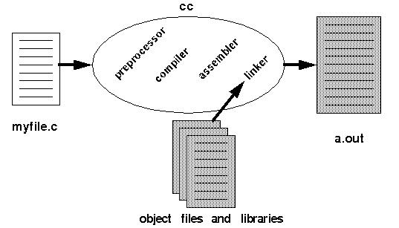
7.1 Computer Languages
Compiler（编译器）
Normally the C’s program building process involves four stages and utilizes different ‘tools’ such as a preprocessor, compiler, assembler, and linker.
正常地，C语言的程序生成过程包括四个主要阶段，并使用了不同的工具，如预处理器，编译器，汇编器和链接器。
计算机专业英语
1-<number>

Slide 21
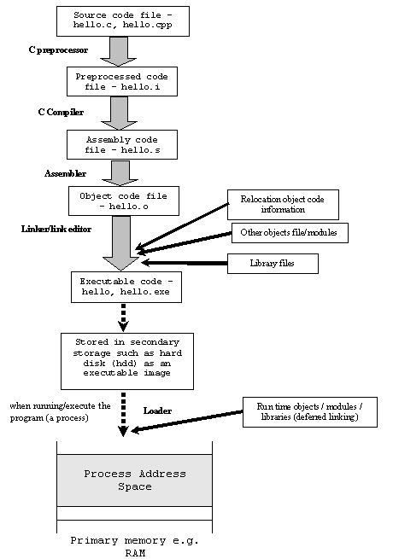
7.1 Computer Languages
Compiler
计算机专业英语
1-<number>

Slide 22
7.1 Computer Languages
Compiler（编译器）
Preprocessing is the first pass of any C compilation. It processes include-files, conditional compilation instructions and macros.
预处理是所有C语言编译过程的第一个步骤。它对包含文件、条件编译指令和宏定义进行处理。
Compilation is the second pass. It takes the output of the preprocessor, and the source code, and generates assembler source code.
编译是第二个阶段。它根据预处理阶段的输出结果和源代码，产生汇编源代码。
计算机专业英语
1-<number>

Slide 23
7.1 Computer Languages
Compiler
Assembly is the third stage of compilation. It takes the assembly source code and produces an assembly list.
The assembler output is stored in an object file.
汇编是是编译的第三个阶段。它产生汇编后的源代码和一个汇编列表。
汇编器的输出存储在一个目标文件中。
计算机专业英语
1-<number>

Slide 24
7.1 Computer Languages
Compiler
Linking is the final stage of compilation. It takes one or more object files or libraries as input and combines them to produce a single (usually executable) file.
In doing so, it resolves references to external symbols, assigns final addresses to procedures/functions and variables, and revises code and data to reflect new addresses (a process called relocation).
链接是编译的最后阶段。它把一个或多个目标文件或库作为输入，把它们结合在一起，产生一个单一可执行的文件。
为了达到这个目的，它解析外部符号的引用、为程序和变量分配最终地址、修正代码和数据来反映新的地址（重新分配程序）。
计算机专业英语
1-<number>

Slide 25
7.1 Computer Languages
Compilers VS. Interpreters
Programs written in a high level language are either directly executed by some kind of interpreter or converted into machine code by a compiler (and assembler and linker) for the CPU to execute.
使用高级语言编写的程序，可通过翻译器直接执行，或被编译器（和汇编器与链接器）转换成机器代码然后通过CPU执行
计算机专业英语
1-<number>

Slide 26
7.1 Computer Languages
Compilers VS. Interpreters
Development cycle （开发周期）
When using a compiler, each time a change is made to the source code, they must wait for the compiler to translate the altered source files and link all of the binary code files together before the program can be executed.
当使用编译器时，源代码每经过一次改动，在程序执行之前，都需要编译器去翻译修改后的源文件和链接所有的二进制代码文件。
计算机专业英语
1-<number>

Slide 27
7.1 Computer Languages
Compilers VS. Interpreters
Development cycle （开发周期）
By contrast, a programmer using an interpreter does a lot less waiting, as the interpreter usually just needs to translate the code being worked on to an intermediate representation (or not translate it at all), thus requiring much less time before the changes can be tested.
相反地，使用翻译器的程序开发者则不需要等待那么久，因为翻译器通常只需将需要执行的代码翻译成中间代码（或者并不进行全部翻译），因此，在改动代码需要进行测试前，它需要更少的时间。
计算机专业英语
1-<number>

Slide 28
7.1 Computer Languages
Compilers VS. Interpreters
Distribution（分发）
A compiler converts source code into binary instruction for a specific processor's architecture, thus making it less portable.
This conversion is made just once, on the developer's environment, and after that the same binary can be distributed to the user's machines where it can be executed without further translation.
编译器针对某一特定的处理器架构，把源代码转换成二进制指令，因此，其可移植性稍差。
这个转换在开发者的环境中只进行一次，此后，所有分发到用户机器的相同二进制指令均可执行，而不需要再进行翻译。
计算机专业英语
1-<number>

Slide 29
7.1 Computer Languages
Compilers VS. Interpreters
Distribution（分发）
An interpreted program can be distributed as source code. It needs to be translated in each final machine, which takes more time but makes the program distribution independent of the machine's architecture.
However, the portability of interpreted source code is dependent on the target machine actually having a suitable interpreter.
翻译后的程序均被分发为源代码。这些程序需要被每一个终端机器进行翻译，这使得它需要更多的时间，但也使得这些程序分发独立于机器的架构。然而，翻译后的源代码的可移植性是和目标机器相关的，需要目标机器有一个合适的翻译器。
计算机专业英语
1-<number>

Slide 30
7.1 Computer Languages
Compilers VS. Interpreters
Efficiency（效率）
The main disadvantage of interpreters is that an interpreted program typically runs slower than if it had been compiled.
The difference in speeds could be tiny or great; often an order of magnitude and sometimes more.
翻译器的最大缺点是翻译后的程序比编译后的程序的执行速度要慢。
速度上的差异可以是微小的，也可以是巨大的。通常是一个数量级，有时候更多。
计算机专业英语
1-<number>

Slide 31
7.1 Computer Languages
Compilers VS. Interpreters
Efficiency（效率）
It generally takes longer to run a program under an interpreter than to run the compiled code
but it can take less time to interpret it than the total time required to compile and run it.
通常地，执行一个翻译程序比执行一个编译程序需要更长的时间，但是，翻译的时间比编译和执行的总时间要短。
计算机专业英语
1-<number>

Slide 32
7.1 Computer Languages
Compilers VS. Interpreters
Efficiency（效率）
This is especially important when prototyping and testing code when an edit-interpret-debug cycle can often be much shorter than an edit-compile-run-debug cycle.
这点对于进行原型构造代码和测试代码是特别重要的，编辑-翻译-调试的周期往往比编辑-编译-运行-调试的周期要短很多。
计算机专业英语
1-<number>

Slide 33
7.1 Computer Languages
Choose the right words:
A compiler translates the code into e . This step is called d , and produces c . The compiler then invokes b , which turns the object file into a .
an executable program
a linker
an object file
compiling
an intermediary form
计算机专业英语
1-<number>

Slide 34
7.1 Computer Languages
Choose the right words:
the C’s program building process involves four stages and utilizes different ‘tools’ such as a c , d , b , and a .
linker
assembler
preprocessor
compiling
interpreter
计算机专业英语
1-<number>

Slide 35
7.1 Computer Languages
Choose the right words:
A compiler translates the code into E . This step is called D , and produces C . The compiler then invokes B , which turns the object file into A .
an executable program
a linker
an object file
compiling
an intermediary form
计算机专业英语
1-<number>

Slide 36
7.1 Computer Languages
Choose the right words:
the C’s program building process involves four stages and utilizes different ‘tools’ such as a C , D , B , and A .
linker
assembler
preprocessor
compiling
interpreter
计算机专业英语
1-<number>

Slide 37
7.2 Object-Oriented Programming
New Words & Expressions:
object-oriented 面向对象的 ongoing adj. 正在进行中的
crisis n. 危机 exploit v. 开发，使用
raw adj. 天然的，原始的 medium n. 媒介，方法
match 相称，匹配 discrete adj. 单个的，离散的
transistor n. 晶体管 resistor n. 电阻
capacitor n. 电容 integration 集成电路
abstraction n. 抽象化 class n. 类
inheritance n. 继承 encapsulation n. 封装
polymorphism n. 多型，多态性 entity n. 实例，实体
Abbreviations :
OOP ( Object-Oriented Programming) 面向对象的编程技术
IC (integrated circuits) 集成电路
LSI（large-scale integration） 大规模集成电路
VLSI（very large-scale integration） 超大规模集成电路
计算机专业英语
1-<number>

Slide 38
7.2 Object-Oriented Programming
Ever since computers became available in the 1950s, it has been software that exploited its power to solve application problems.
Machine code, capable of driving the raw hardware, was the first language available to programmers.
自从50年代计算机开始进入实用阶段以来，软件就在解决应用问题的能力方面崭露头角。
控制基本硬件的机器代码是程序员使用的第一种语言。
计算机专业英语
1-<number>

Slide 39
7.2 Object-Oriented Programming
Sequences of code statements were the earliest form of software.
It was soon recognized that the communication medium between programmer and computer is a critical factor in the programming productivity and quality of the overall software product.
顺序代码语句是软件的最早形式。
人们很快就认识到，编程效率和整个软件产品质量的关键因素是程序员和计算机之间的通信手段。
计算机专业英语
1-<number>

Slide 40
7.2 Object-Oriented Programming
While computers, the hardware, underwent revolution after revolution, using faster and ever more powerful components, the software technology has significantly lagged behind in matching these advances.
Hardware technology has been revolutionized several times: from tubes to discrete transistors, resistors and capacitors to board-level integration to integrated circuits.
当计算机硬件由于使用速度更快、功能更强的器件而不断更新换代的时候，软件技术则大大滞后，与硬件的发展不相匹配。
硬件技术已经历了几次革命：从电子管到单个晶体管、电阻和电容器元件，到板级集成电路，到整个集成电路。
计算机专业英语
1-<number>

Slide 41
7.2 Object-Oriented Programming
Moore’s law（摩尔定律）
Moore‘s law is the observation that the number of transistors in a dense integrated circuit doubles approximately every two years.
The period is often quoted as 18 months, and chip performance would double every 18 months.
摩尔定律是观察密集集成电路中晶体管的数量大约每两年翻一番。
这个周期通常被称为18个月，芯片性能每18个月增加一倍。
计算机专业英语
1-<number>

Slide 42
7.2 Object-Oriented Programming
Even integrated circuits have undergone several significant evolutionary steps: from large-scale integration (LSI) technology to very large scale integration (VLSI), and eventually wafer (晶圆) scale integration.
Hardware engineering was able to keep up with this pace by developing new techniques to manage the exploding complexity of a modern computer system.
即使是集成电路也经历了几次重大的演变：从大规模集成电路(LSI)技术到超大规模集成电路(VLSI)，并且又发展了晶片上大规模集成技术。
硬件工程能够保持这种发展势头，是因为新技术的发展可以对付现代计算机系统与日俱增的复杂性。
计算机专业英语
1-<number>

Slide 43
7.2 Object-Oriented Programming
Ever since computers were used to solve application problems, it was the task of software to bridge the gap between concepts in an application and computer concepts.
On one side of the gap are the concepts of an application: for example, customer files to organize, accounts to maintain, or rockets to launch.
自从计算机用于解决应用问题以来，软件的任务就是在应用概念和计算机概念之间架起一座桥梁。
其一端是应用概念，如客户文件的组织，账户的维护或火箭的发射；
计算机专业英语
1-<number>

Slide 44
7.2 Object-Oriented Programming
On the other side are the concepts understood by a computer system: electric impulses, micro code, machine code instructions, and programming language constructions.
The typical programming task is to translate the application concepts into computer concepts.
If the translation succeeds and the computer solves the application problem, a successful software product has been developed.
另一端是计算机系统所理解的概念，电脉冲，微代码，机器代码指令和程序设计语言结构。
典型的程序设计任务是将应用概念翻译成计算机概念。如果翻译成功了，并且计算机也解决了这个应用问题，一个成功的软件产品就开发出来了。
计算机专业英语
1-<number>

Slide 45
7.2 Object-Oriented Programming
Advances in software technology are driven by the desire to make the transition from application concepts to computer concepts easier.
Advances in software technology have narrowed the gap from both sides.
希望较容易地把应用概念转变为计算机概念这一愿望推动着软件技术的进步，这种进步从两端使间隙变窄了。
计算机专业英语
1-<number>

Slide 46
7.2 Object-Oriented Programming
On one side they provided software design principles and techniques that allow the programmer to express an application problem closer to computer system terms.
Software design principles, such as abstraction, information hiding, modularization and stepwise refinement, allow the programmer to conceptualize application concepts and to ease their transformation into computer system concepts.
在一端,软件技术的进步提供一些软件设计原理和技术，使得程序员用更接近于计算机系统的术语表达应用问题。
软件设计原理，诸如抽象化、信息隐蔽、模块化和分段优化，允许程序员对应用概念概念化，从而更容易地将之转变成计算机系统概念。
计算机专业英语
1-<number>

Slide 47
7.2 Object-Oriented Programming
On the other side, software technology has advanced the expressive power of the tools used to manipulate a computer system: the programming languages.
在另一端，软件技术的发展使得操纵计算机系统的工具——程序设计语言具有更强的表达能力。
计算机专业英语
1-<number>

Slide 48
7.2 Object-Oriented Programming
In the late 1960s it was recognized that a combination of both forces--software design technology and advances in programming languages--may be possible.
The resulting language construct was a class.
60年代末，认识到将两种力量(即软件设计技术和程序设计语言的进展)结合起来是可能的，这样形成的语言结构就是“类”。
计算机专业英语
1-<number>

Slide 49
7.2 Object-Oriented Programming
A class implements the concepts of abstraction, modularization, and data hiding.
It does so by grouping a user-defined type with all procedures and functions that can be applied to it.
Classes allow inheritance. The concept of inheritance relates to the design concept of stepwise refinement and also allows the reuse of existing code and data structures in a class.
类通过按所有过程和函数对用户定义的类型进行分组而实现抽象化、模块化和数据隐蔽的概念。
类允许继承，继承的概念与分段优化的设计概念相关,并允许重新使用在同一类中的现有代码和数据结构。
计算机专业英语
1-<number>

Slide 50
7.2 Object-Oriented Programming
The engineering of a class concept represents a step to software technology similar to the development of an integrated circuit (IC) to hardware.
类的概念工程象征着朝向软件技术迈开的一步，类似于集成电路的开发对于硬件的贡献。
计算机专业英语
1-<number>

Slide 51
7.2 Object-Oriented Programming
As new hardware systems can be built by using (or modifying) off-the-shelf ICs, it is now possible to build software systems by reusing (or extending) off-the-shelf classes.
"Class" is the central concept in object-oriented programming. Object-oriented programming promises to significantly narrow the semantic gap.
如同可以通过使用或修改流行的集成电路来做新的硬件系统一样，可以重新使用或扩展现有的类去构成软件系统。
“类”是面向对象程序设计的核心概念。面向对象的程序设计有望缩小以上所提到的语义间隙。
计算机专业英语
1-<number>

Slide 52
7.2 Object-Oriented Programming
Some of the benefits and flexibility of object-oriented programming stem from this separation of function invocation and implementation.
The invocation of a functionality is termed "the sending of a message to an object."
The execution of its implementation is termed "the receiver of the message executes the corresponding method.“
面向对象的程序设计的一些优点和灵活性源于将功能的调用和实现相互分离这一技术。
功能的调用可表达为“把信息送给对象”。
实现的过程被称为“信息接收者执行相应的方法”。
计算机专业英语
1-<number>

Slide 53
7.2 Object-Oriented Programming
The separation of message and method greatly adds to the flexibility possible in an object-oriented program.
In our example messages are sent to the plane objects.
Each plane object receives a message and executes its desired behavior.
信息和方法的分离大大地增加了面向对象程序灵活性。
在我们的例子中，信息是送给飞机对象的，每一飞机对象接收一个信息并执行其所要求的行为。
计算机专业英语
1-<number>

Slide 54
7.2 Object-Oriented Programming
In effect, our program "computes" by sending messages to all participating objects.
In general, we can observe an object-oriented program as a collection of objects that communicate by sending messages.
实际上，我们的程序通过向所有在场的对象发送信息而进行“计算”。
一般来讲，我们可以把面向对象的程序看作是通过发送信息进行通信的各个对象的集合。
计算机专业英语
1-<number>

Slide 55
7.2 Object-Oriented Programming
Definition
Object-oriented programming (OOP) is a programming paradigm based on the concept of "objects",
which may contain data, in the form of fields, often known as attributes; and code, in the form of procedures, often known as methods.
面向对象编程是基于对象这个概念的一种编程范式，对象可能包含数据，以域的形式呈现，通常被叫做属性。
对象还可包含代码，以过程的形式呈现，通常也被叫做方法
计算机专业英语
1-<number>

Slide 56
7.2 Object-Oriented Programming
Definition
A feature of objects is that an object’s procedures can access and often modify the data fields of the object with which they are associated.
In OOP, computer programs are designed by making them out of objects that interact with one another.
There is significant diversity of OOP languages, but the most popular ones are class-based, meaning that objects are instances of classes.
对象的一个特征是对象的方法可以访问及经常改变与对象相关联的数据域。在面向对象编程中，计算机程序设计都把它们设计成对象，并使它们进行交互。
面向对象程序语言具有强烈的多样性，但最流行的是基于类的，这预示着对象是类的一个实例。
计算机专业英语
1-<number>

Slide 57
7.2 Object-Oriented Programming
Encapsulation（封装）
Encapsulation is an Object Oriented Programming concept that binds together the data and functions that manipulate the data, and that keeps both safe from outside interference and misuse.
Data encapsulation led to the important OOP concept of data hiding.
封装是面向对象编程概念中把数据和操作数据的方法捆绑起来，保证数据和方法安全，不被外部干涉或滥用。
数据封装导致面向对象编程中数据隐藏的重要概念产生。
计算机专业英语
1-<number>

Slide 58
7.2 Object-Oriented Programming
Encapsulation （封装）
Encapsulation prevents external code from being concerned with the internal workings of an object.
This facilitates code refactoring, for example allowing the author of the class to change how objects of that class represent their data internally without changing any external code.
封装使得使用外部代码时不需考虑对象的内部操作。
这促进了代码重构，比如，允许类的作者去修改类对象的数据，而不能修改任何外部代码。
计算机专业英语
1-<number>

Slide 59
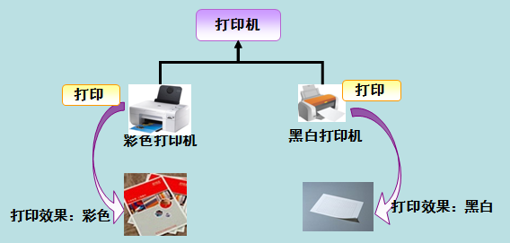
7.2 Object-Oriented Programming
Polymorphism（多态性）
Subtyping, a form of polymorphism, is when calling code can be agnostic [ægˈnɑ:stɪk] as to whether an object belongs to a parent class or one of its descendants. (多态是同一个行为具有多个不同表现形式或形态的能力)
This is another type of abstraction which simplifies code external to the class hierarchy.
子类型化，多态性的一种形式，是指调用代码是非确定性的，对象可属于它的父类，又可以属于它的后代中的一个。
这是抽象化的另一种，简化了类层次结构的外部代码，
计算机专业英语
1-<number>

Slide 60
value compile alphabet assembler instruction
interpret utility programmer communication load
(1)(load): To transfer (data) from a storage device into a computer’s memory.
(2)(compile): To translate (a program) into machine language.
(3)(value): An assigned or calculated numerical quantity.
(4)(instruction): A machine code telling a computer to perform a particular operation.
(5) (interpret): To translate a statement or instruction into executable from and then execute it.
(6) (alphabet): The letters of a language, arranged in the order fixed by custom.
(7) (assembler): A program operating on symbolic input data to produce the equivalent executable machine code.
(8) (utility): A program designed to perform a particular function; the term usually refers to software that solve narrowly focused problems or those related to computer system management.
(9) (communication): The technology employed in transmitting message.
(10) (programmer): One who writes computer programs.
计算机专业英语
1-<number>

Slide 61
enforces interact environment interpretation executable
Servers compiler dynamic single applet
java is A programming language expressly designed for use in the distributed (1)environment of the Internet. IT was designed to have the "look and feel“ of the C++ language, but it's simpler to use than C++ and (2) enforces an object oriented programming model. Java can be used to create complete applications that may run on a (3)single computer or be distributed among (4)servers and clients in a network. It can also be used to build a small application module or (5)applet for use as part of a Web page. Applets make it possible for a web page user to (6)interact with the page.
The Java virtual machine includes an optional just-in-time (7) compilerthat dynamically compiles bytecode into (8)executable code as an alternative to interpreting one bytecode instruction at a time. In many case, the (9)dynamic JIT compilation is faster then the virtual machine (10)interpretation .
计算机专业英语
1-<number>

Slide 62
value compile alphabet assembler instruction
interpret utility programmer communication load
(1)( load): To transfer (data) from a storage device into a computer’s memory.
(2)(compile): To translate (a program) into machine language.
(3)(value): An assigned or calculated numerical quantity.
(4)(instruction): A machine code telling a computer to perform a particular operation.
(5) (interpret): To translate a statement or instruction into executable from and then execute it.
(6) (alphabet): The letters of a language, arranged in the order fixed by custom.
(7) (assembler): A program operating on symbolic input data to produce the equivalent executable machine code.
(8) (utility): A program designed to perform a particular function; the term usually refers to software that solve narrowly focused problems or those related to computer system management.
(9) (communication): The technology employed in transmitting message.
(10) (programmer): One who writes computer programs.
计算机专业英语
1-<number>

Slide 63
enforces interact environment interpretation executable
Servers compiler dynamic single applet
java is A programming language expressly designed for use in the distributed (1)environment of the Internet. IT was designed to have the "look and feel“ of the C++ language, but it's simpler to use than C++ and (2)enforces an object oriented programming model. Java can be used to create complete applications that may run on a (3)single computer or be distributed among (4)servers and clients in a network. It can also be used to build a small application module or (5)applet for use as part of a Web page. Applets make it possible for a web page user to (6)interact with the page.
The Java virtual machine includes an optional just-in-time (7)compiler that dynamically compiles bytecode into (8)executable code as an alternative to interpreting one bytecode instruction at a time. In many case, the (9)dynamic JIT compilation is faster then the virtual machine (10)interpretation .
计算机专业英语
1-<number>

